Slide 1
SAS Stored Processes and Developing Web Applications
Phil Mason
Independent SAS Consultant

Slide 2
Contents
Creating a Simple Web App using Enterprise Guide
Make a report
Turn it into a Stored Process
Use Stored Process Web App
Make a better Web App
Add some HTML
Add Java Script
Make the best Web App
Use a Java Script framework
Notes:
Idiots guide to creating a simple Web App. I have tried to keep the required knowledge to a minimum.

Slide 3
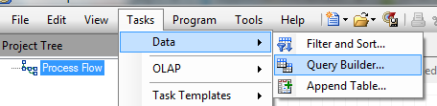
Make a report
Use Enterprise Guide
Build a query
Notes:
Even if you cant write code you can create a report.
Select Query Builder

Slide 4
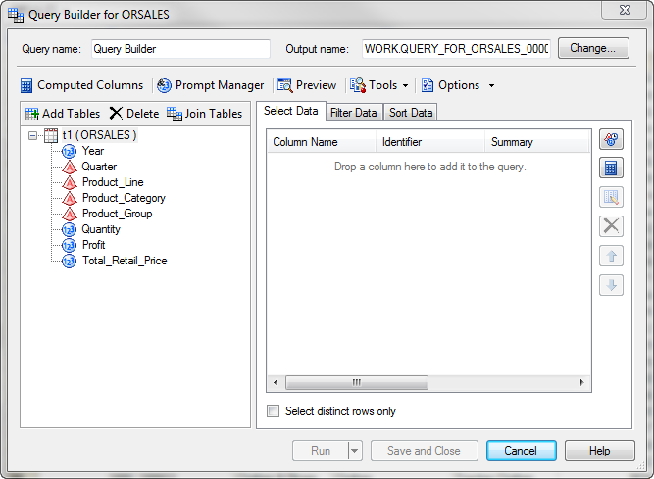
Query Builder
Notes:
Choose a dataset, and you can see the variables available

Slide 5
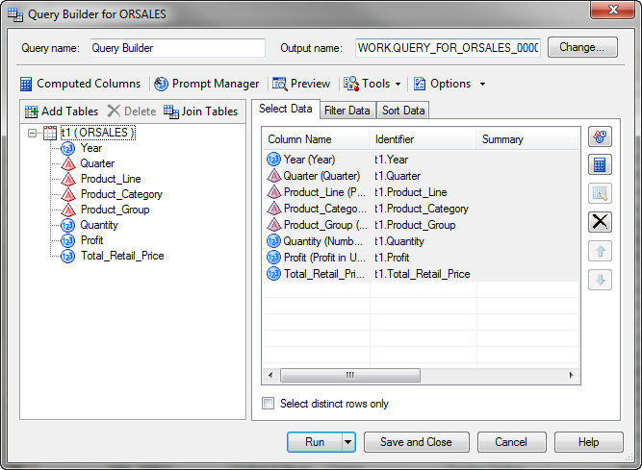
Query builder
Notes:
Drag the variables you want across into select data. Then click on Preview to see the code.

Slide 6
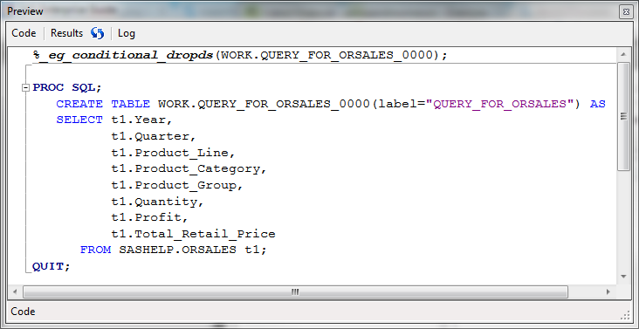
Now you have a query
Notes:
You can see the code. You could skip this whole step and write your own of course.

Slide 7
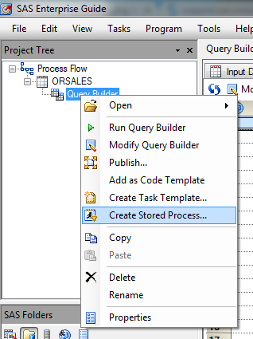
Make a Stored Process
Notes:
Going back to the Process Flow, you can right click and select Create Stored Process.

Slide 8
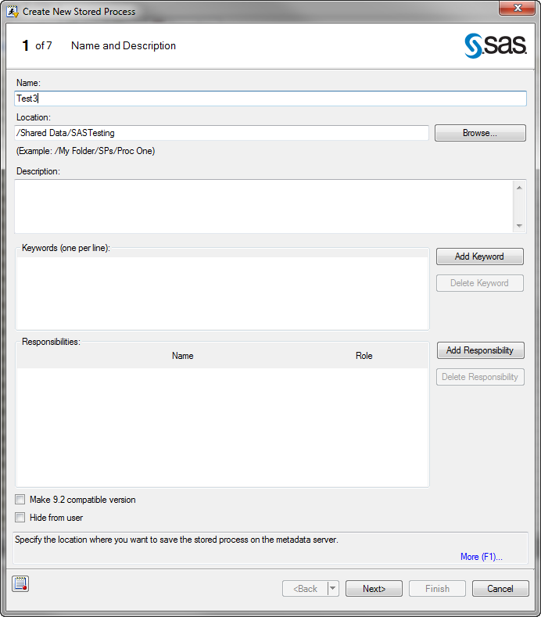
Name it
Notes:
1st page of Wizard. Give your stored process a name and Browse to a location to save it.

Slide 9
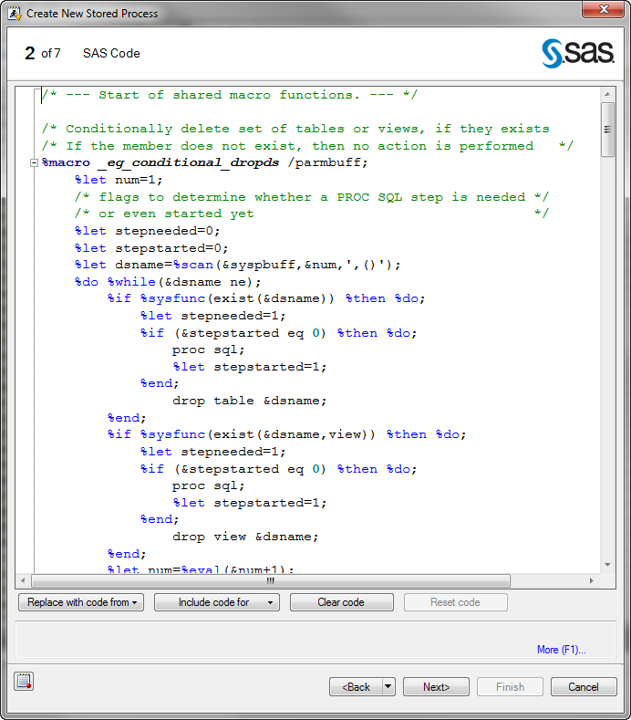
View code
Notes:
2nd page of Wizard – You will see the Stored process code that has been created by SAS. Basically is code from the report with some bits put before it and after it.

Slide 10
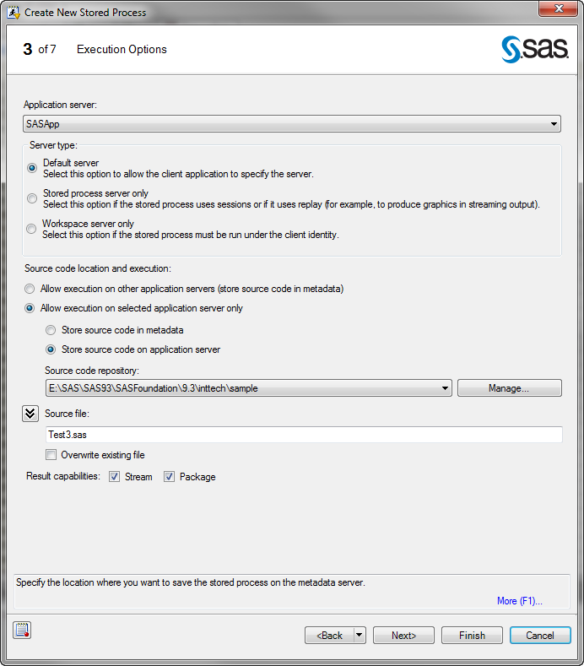
Pick Repository
Notes:
3nd page of Wizard – generally let things default, but the first time you use this you will probably have to choose a code repository using the Manage button.

Slide 11
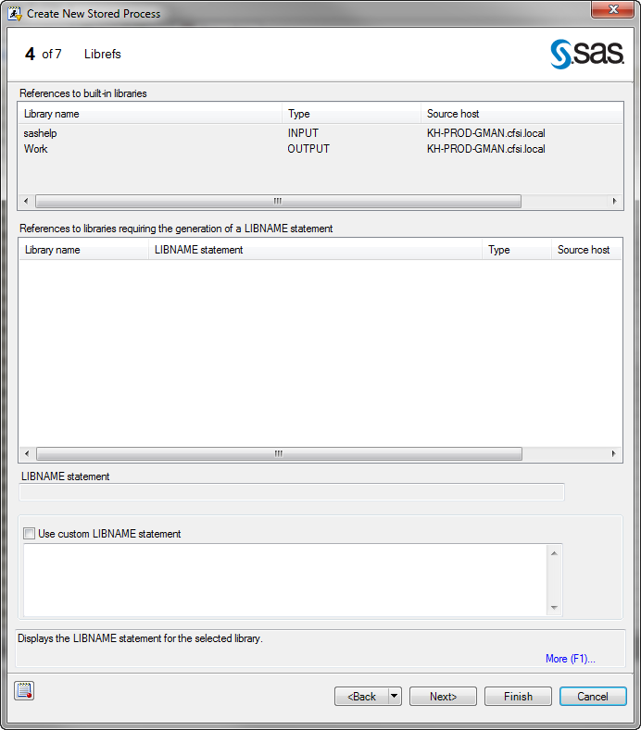
Librefs
Notes:
4th Page of Wizard – you might need to define a libref to point to your data, but in this case we are using SASHELP which was pre-defined.

Slide 12
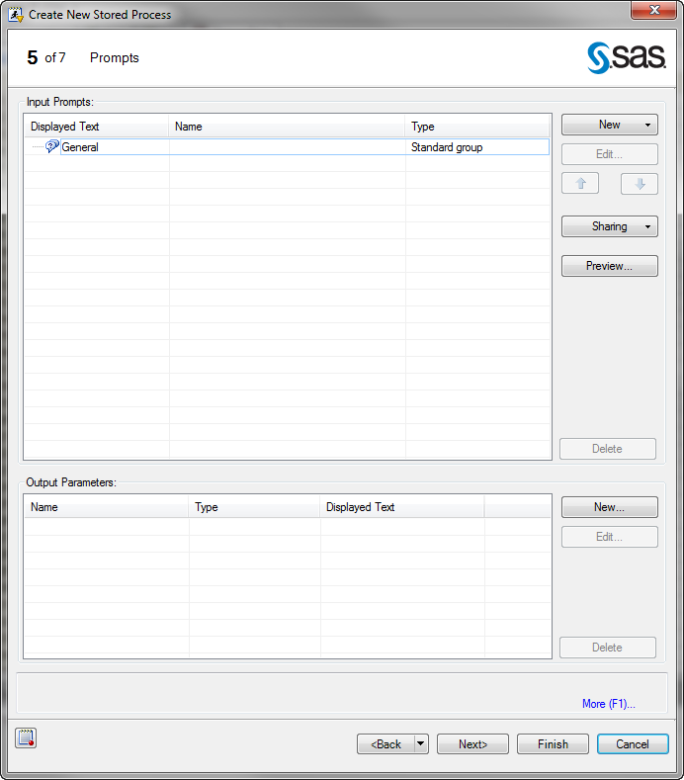
Prompts
Notes:
5th page of Wizard – We could specify INPUT prompts which can be used to pass values into our program at run time, but we wont for now.

Slide 13
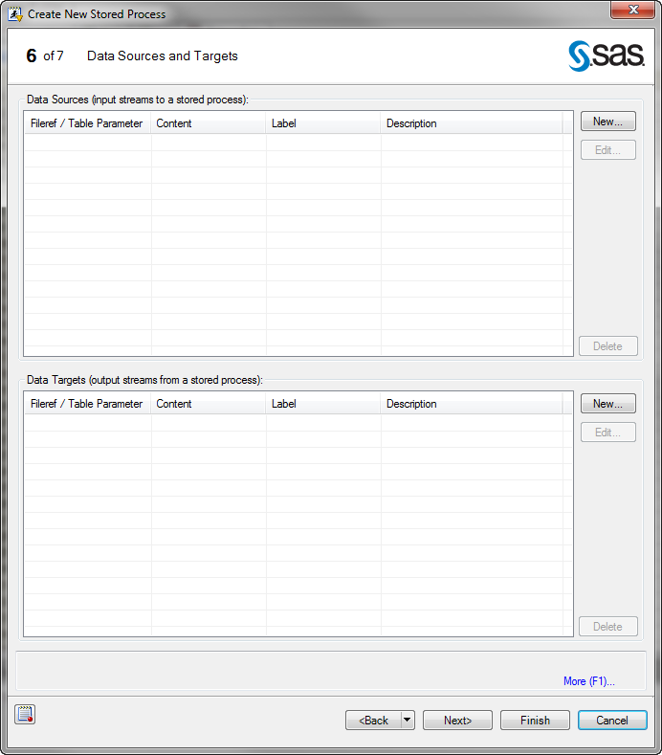
Data Sources & Targets
Notes:
2nd last page of Wizard – this is mainly used with Web Services, so we wont use this for now.

Slide 14
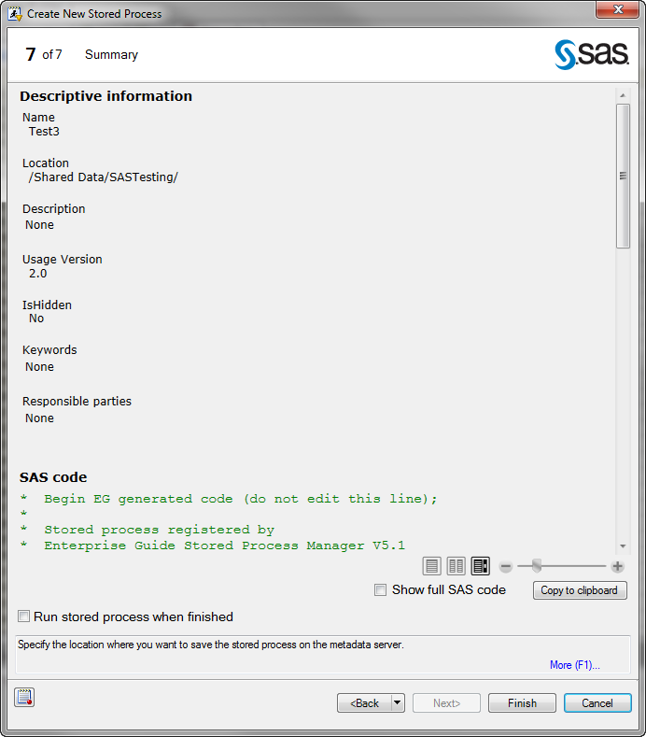
Review
Notes:
Last page of Wizard – gives a nice summary, allowing us to see code and run the process to test it. Press Finish to complete creation of the stored process.

Slide 15
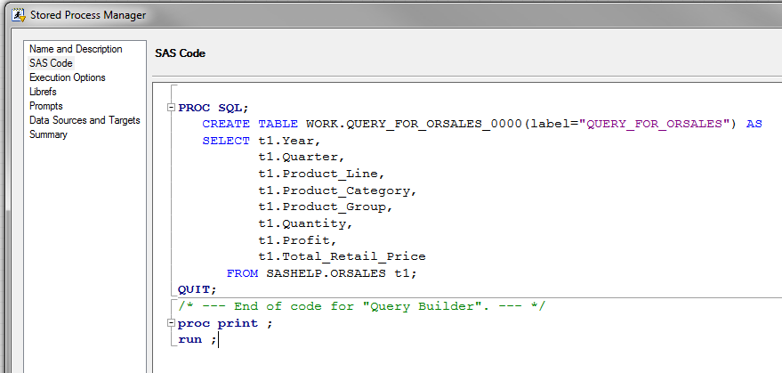
Edit Stored Process
Notes:
We can go back and edit the Stored Process, and examine the code. Since our code only created a dataset, we need to add something to display it – a Proc Print.

Slide 16
Stored Process
Composed of:
A metadata component
A code component
Alternative way to create a Stored Process
Create the code with an editor
In Management Console create the metadata/code

Slide 17
Let’s take a quick look at Management Console

Slide 18
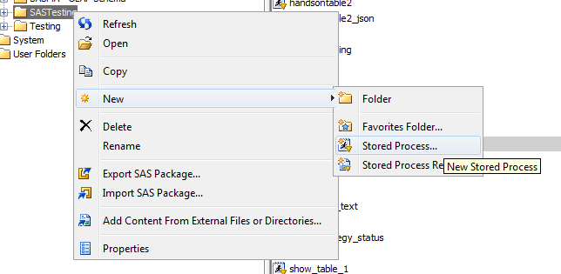
Create using Management Console

Slide 19
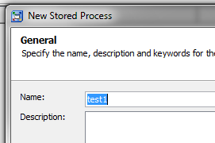
Name it

Slide 20
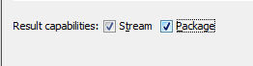
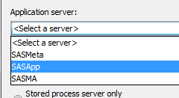
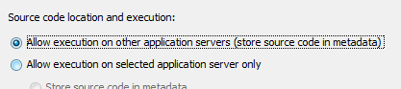
Execution settings
Select server to run it on
Specify we want to stream output and that we can produce a package
Keep code in metadata

Slide 21
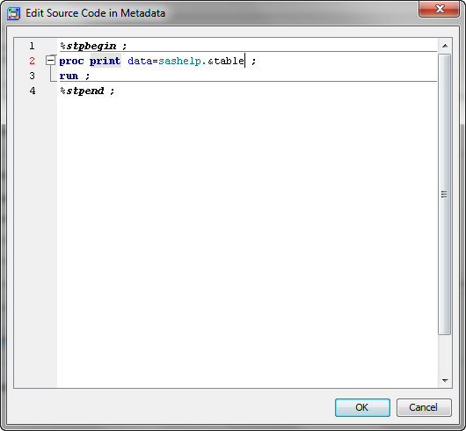
Edit Source Code

Slide 22
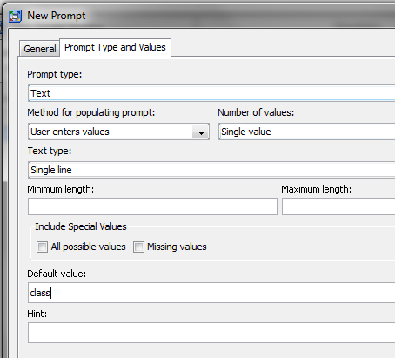
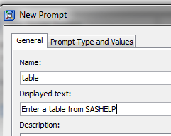
Define parameters

Slide 23
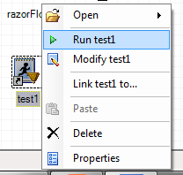
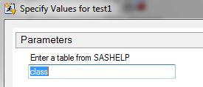
Run it via Enterprise Guide

Slide 24
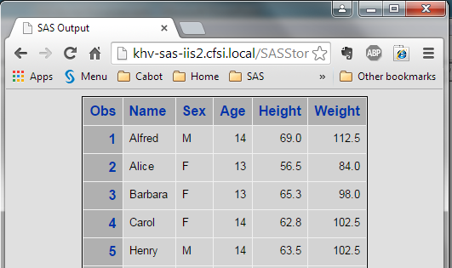
Run it via Web Browser

Slide 25
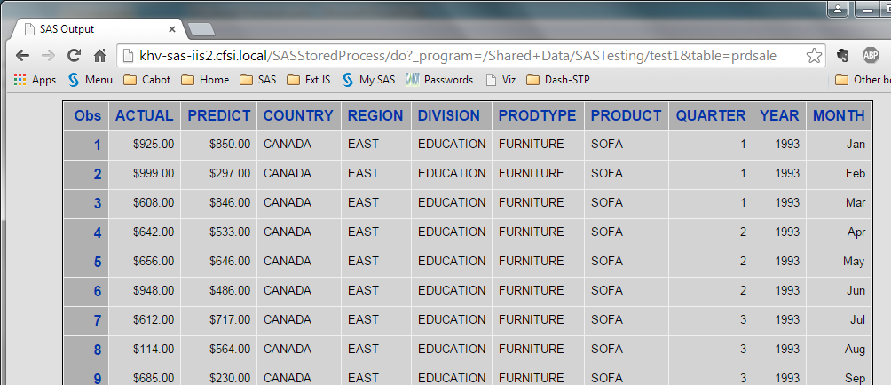
Run with a parameter specified

Slide 26
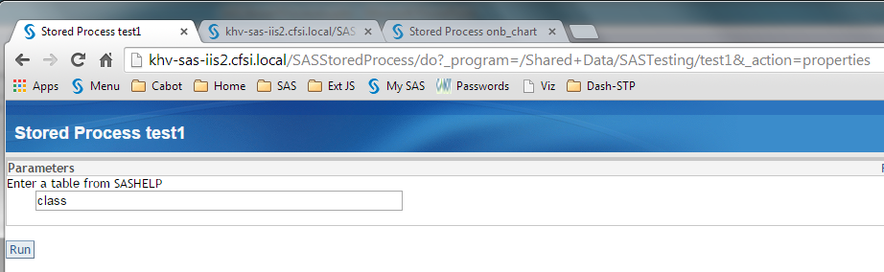
Run and prompt for parameters

Slide 27
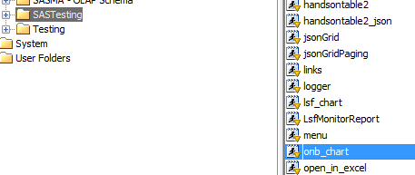
Edit a Stored Process with Management Console
Find the one you want and double click it

Slide 28
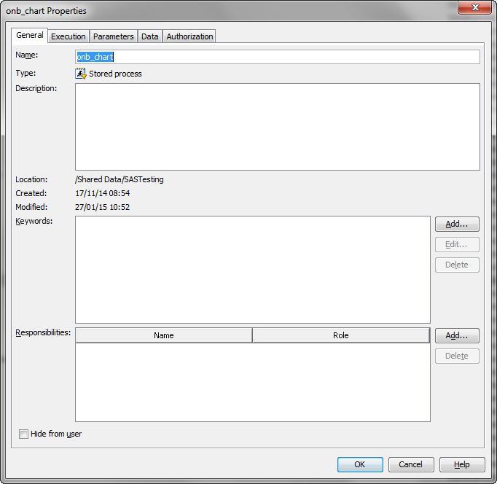
Management Console
Name & Location

Slide 29
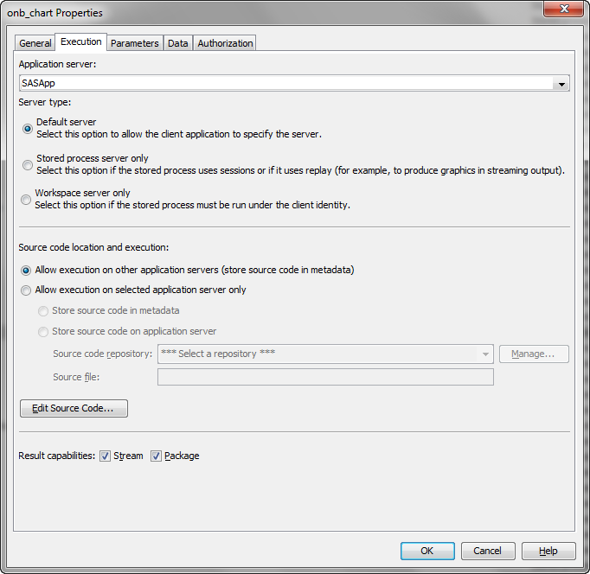
Management Console

Slide 30
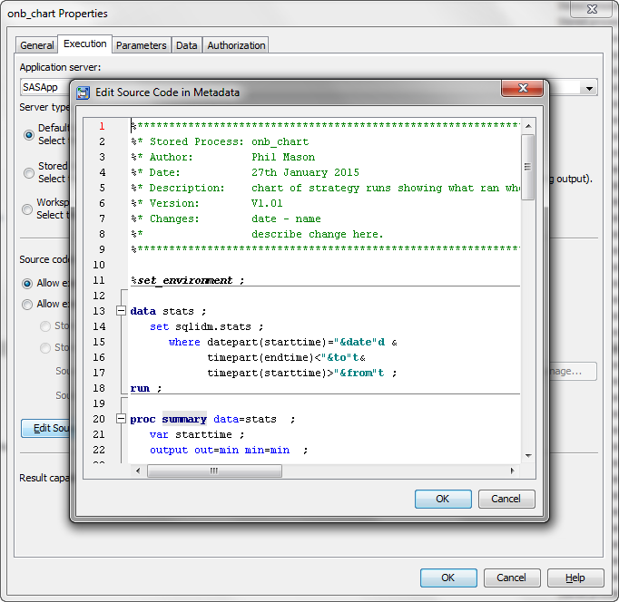
Management Console

Slide 31
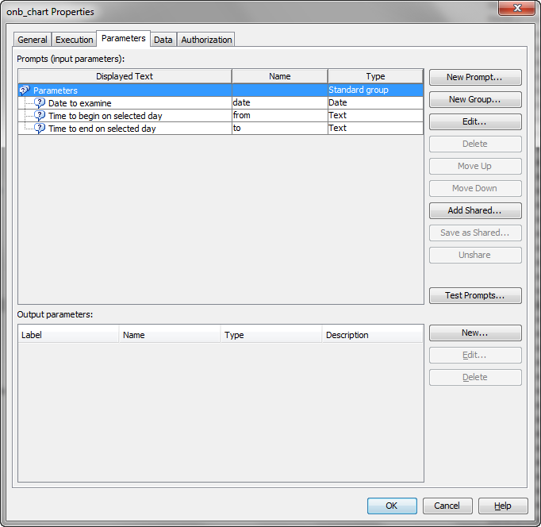
Management Console

Slide 32
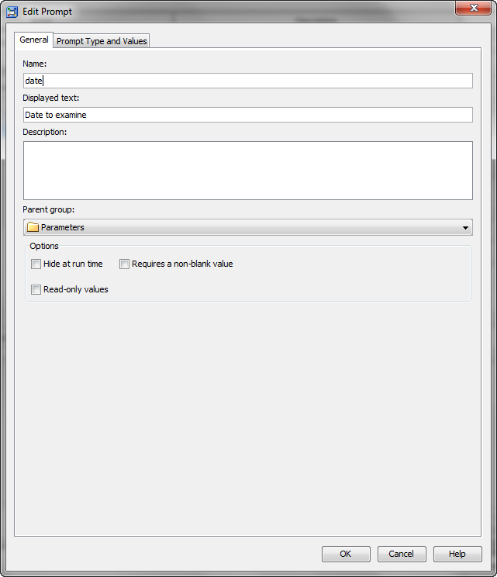
Management Console

Slide 33
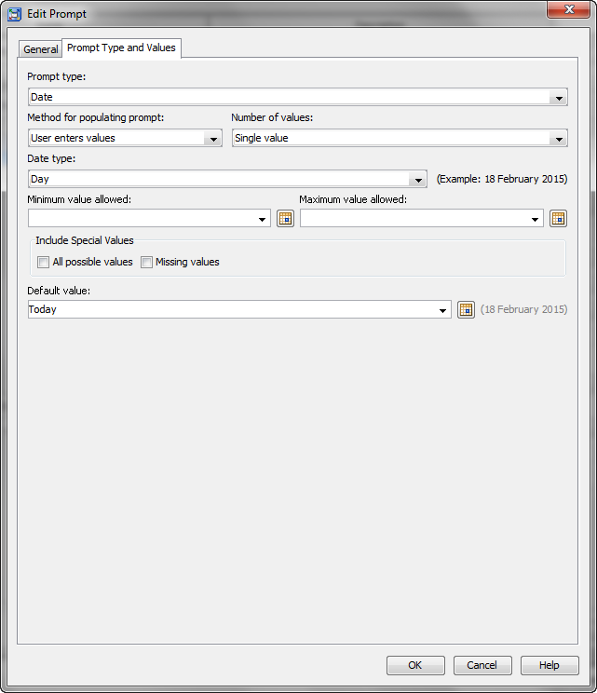
Management Console

Slide 34
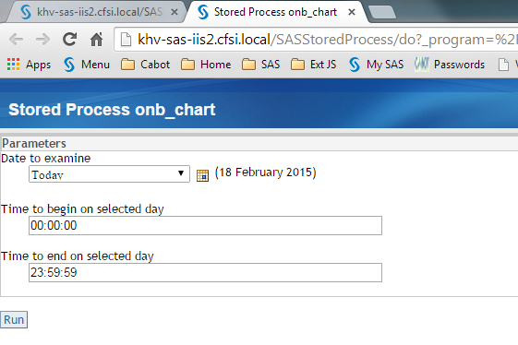
Management Console

Slide 35
Stored Process Web Application
Part of Integration Technologies
Allows running a stored process
From a web browser
From an application such as EXCEL, MS Word
Parameters passed on URL appear as macro variables to Stored Process

Slide 36
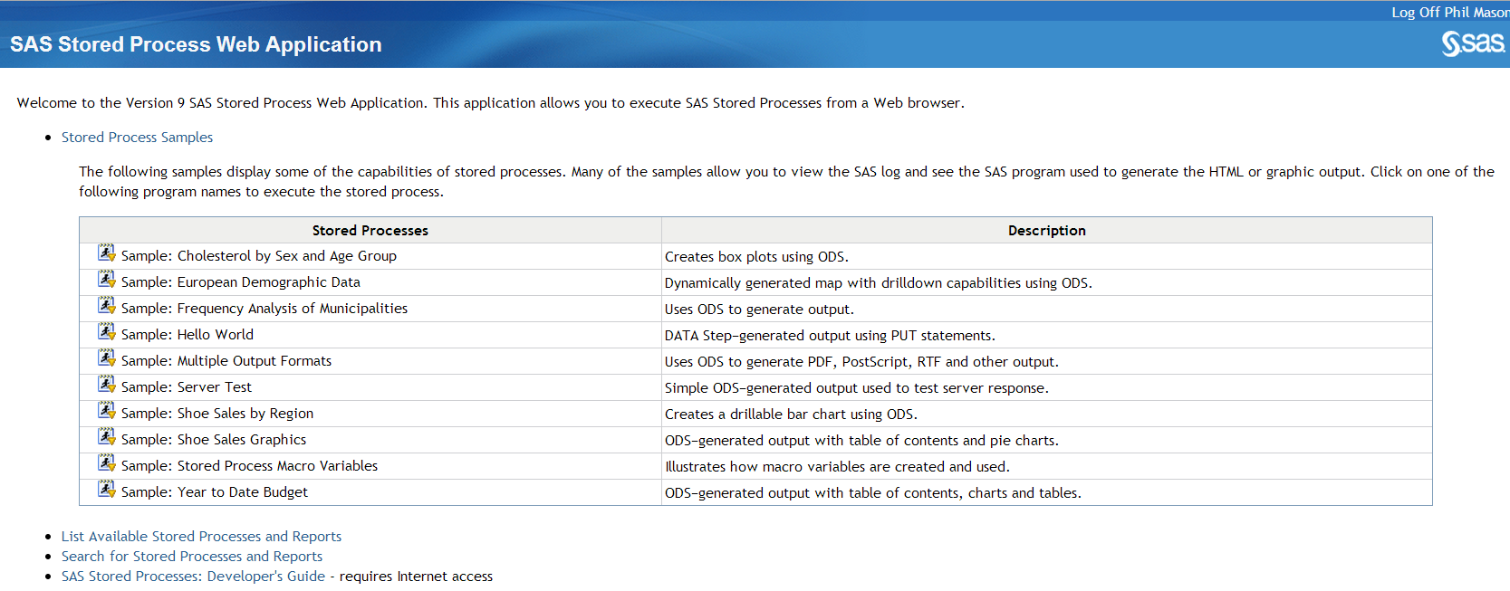
Stored process web application
Notes:
Start the Stored process web application. We can List Available Stored Processes & Reports, and find our one.

Slide 37
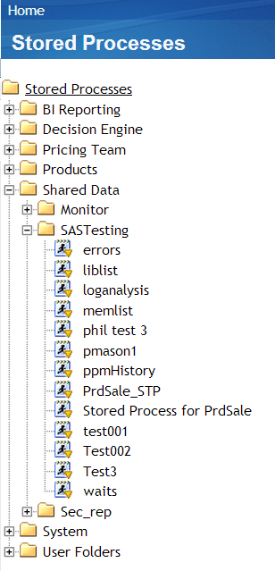
Get a menu down left
Notes:
So we go and find our one, called Test3. Clicking on it will run it.

Slide 38
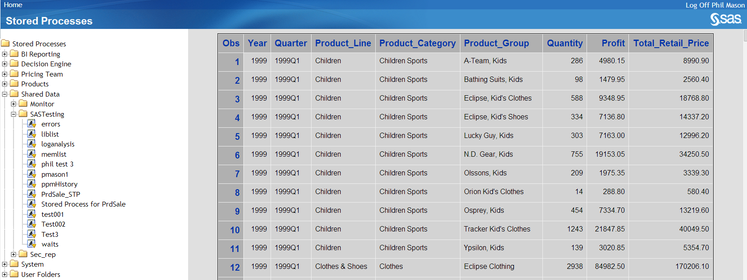
Run stored process from web app
Notes:
Report runs and is shown in a window to the right of the list.

Slide 39
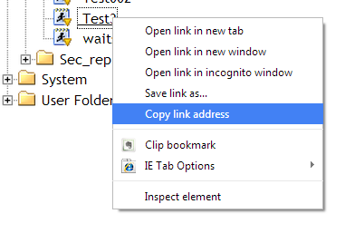
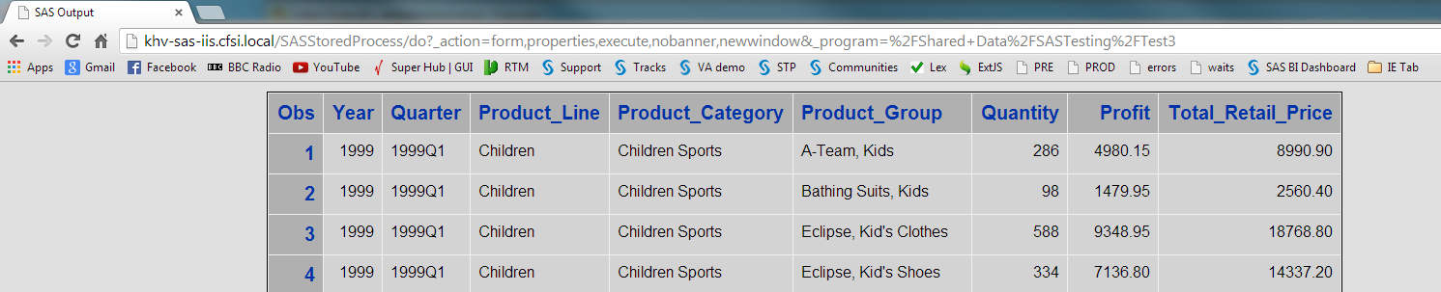
Run stored process from browser
Notes:
We can get the URL used to run the Stored Process by right clicking on it, and copying the link address.

Slide 40
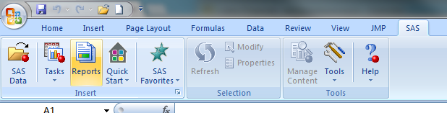
Run stored process from excel
Notes:
If you have the Office Add-in you can run your stored process from various Microsoft Office products. Open EXCEL and select Reports.

Slide 41
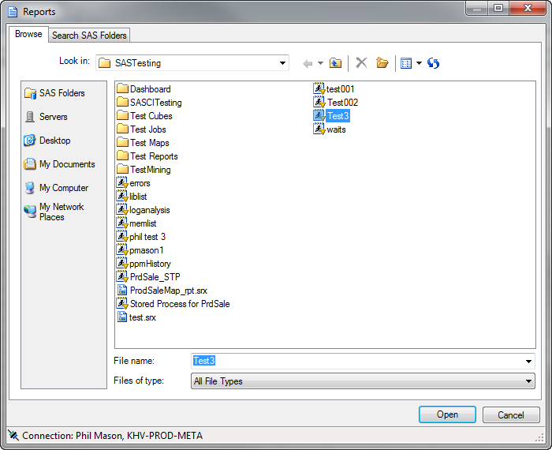
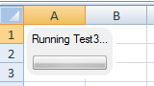
Open one to run it
Notes:
Now you browse and find your Stored Process

Slide 42
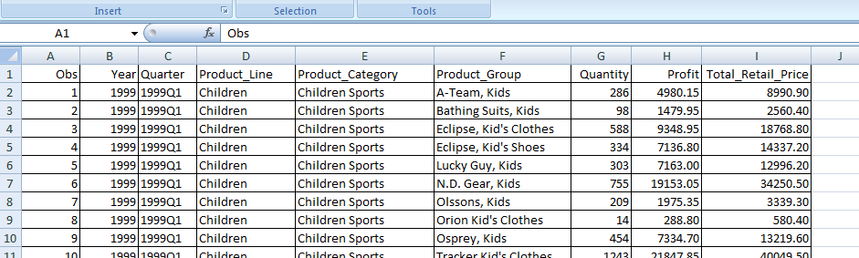
Results of run appear in EXCEL
Notes:
Then you will get your results, automatically imported into EXCEL for you.

Slide 43
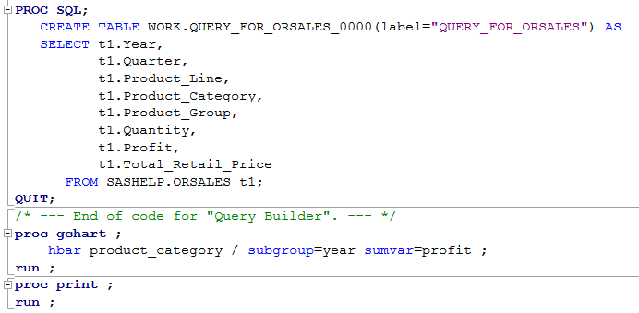
Add a Graph to Stored Process
Notes:
Now I will add a graph to my Stored Process. So I go back to the edit it, and add a Proc Gchart with a horizontal bar chart.

Slide 44
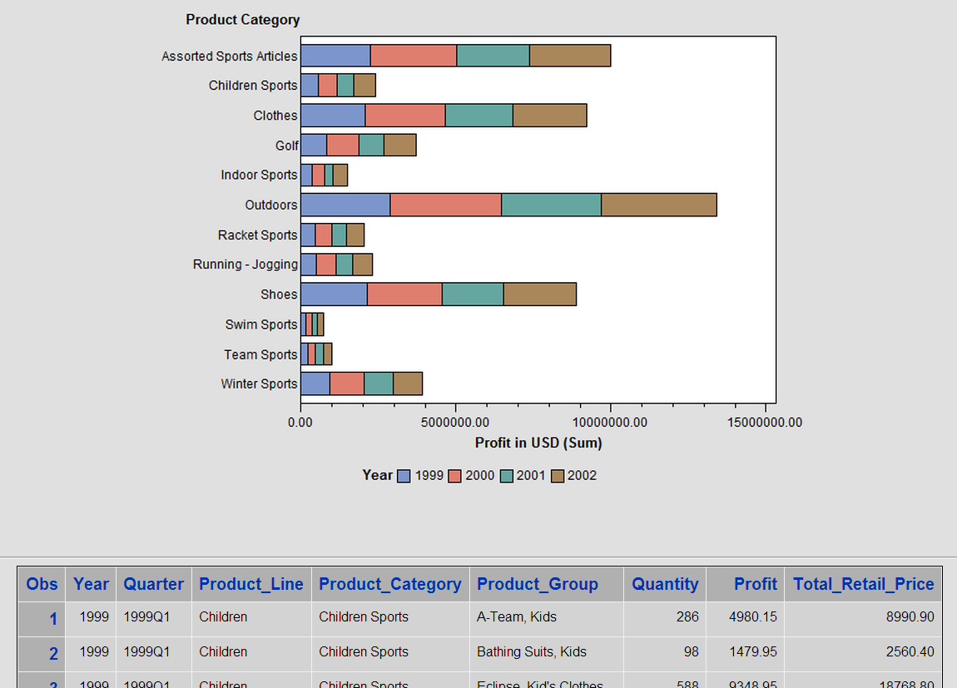
Result in web browser
Notes:
Now running the URL in a web browser will show us the graph followed by the table.

Slide 45
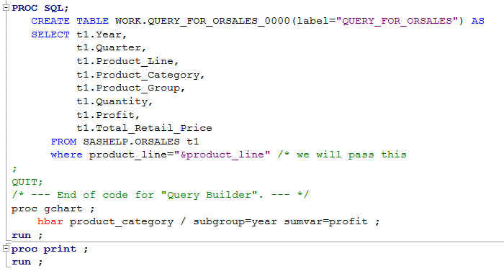
Add parameter
Notes:
To make the stored process more flexible, I will add a parameter. This is easiest done by adding a macro variable, typically with a Where.

Slide 46
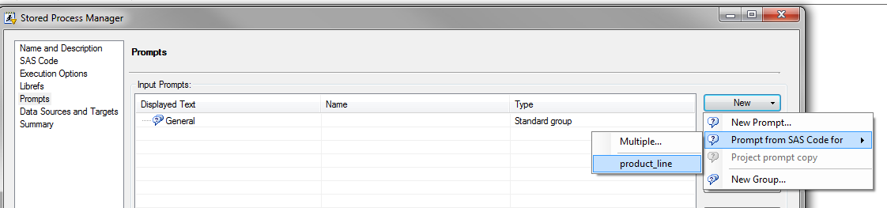
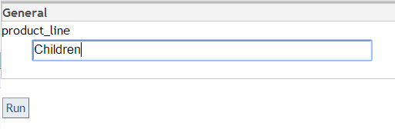
Add prompt for macro parameter added
Notes:
Now if we go to the Prompts part of the Stored Process wizard, we can have it scan our code for macro variables and create prompts for them. Easy.

Slide 47
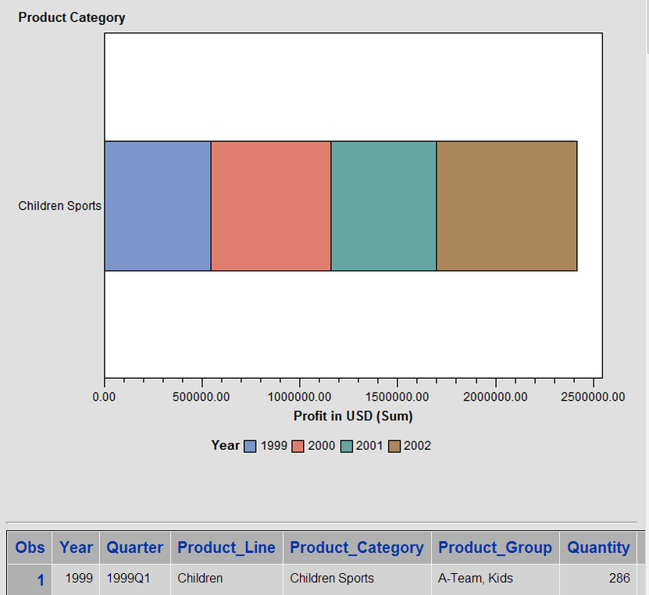
Stored Process using parameter via prompt
Notes:
It then runs using that parameter.

Slide 48
URL showing parameter passed
http://my.server/SASStoredProcess/do? _program=%2FShared+Data%2FSASTesting%2FTest3&product_line=Children
Notes:
Looking at that URL that was used to make this report shows us what has been added to the URL to pass the parameter in. This is how parms are passed in.

Slide 49
Make a better Web App
Use some HTML
Gives us some more control
Use some JavaScript
Great for adding more interactivity
Allows programming to control User Interface

Slide 50
Simple HTML
<html> <body>
<h1>Pick a report to run</h1>
<a href="http://my.server/SASStoredProcess/do?
_program=%2FShared+Data%2FSASTesting%2FTest3
&product_line=Children"> Children</a><p>
<a href="http://my.server/SASStoredProcess/do?
_program=%2FShared+Data%2FSASTesting%2FTest3
&product_line=Clothes+%26+Shoes">Clothes & Shoes</a><p>
<a href="http://my.server/SASStoredProcess/do?
_program=%2FShared+Data%2FSASTesting%2FTest3
&product_line=Outdoors">Outdoors</a><p>
<a href="http://my.server/SASStoredProcess/do?_program=%2FShared+Data%2FSASTesting%2FTest3
&product_line=Sports">Sports</a><p>
</body> </html>
Notes:
I want to make a menu to allow people to choose values for a parameter, and then run my stored process using the value. Do this using simple HTML. Each line has a URL which will pass a particular value for my parameter.

Slide 51
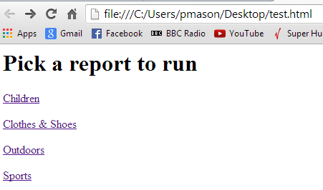
HTML Menu
Notes:
Here is my HTML when it is displayed. I can just click on a link and run my stored process with that parameter.

Slide 52

Report shown in browser
Notes:
Clicking on Sports takes me to this screen, showing me my report.

Slide 53
Using a form to run a Stored Process
HTML form is great for making User Interfaces
Form tag
Make the first part of URL
Input tag, using different type settings
Text – fields for text
Password – passwords where text is hidden
Radio – radio buttons
Checkbox – check boxes
Submit – submit buttons to execute URL using parts of form
Notes:
Now lets see what the form looks like that can make us a menu

Slide 54

HTML using Form
Notes:
I can make some more flexible HTML by using a form. This lets me add various prompts to my page and each one will be able to pass some information to the stored process.
GET – shows URL.
ACTION – first part of URL
Other parts of FORM, their NAME is the parameter name, their VALUE is the value.
Some characters should be encoded when passed in as parms – e.g. space becomes _, & becomes %26

Slide 55

What’s displayed
Notes:
Using the select means we get a drop down menu on our web page. We make a selection, press run and the URL is made up and called.

Slide 56
Writing directly from Stored Process to browser
_webout
Reserved fileref for writing from Stored Process to browser
%stpbegin macro sends output from procs to _webout
%stpend stops output going to _webout
Can write from a datastep to _webout
Best to turn automatic Stored Process macros off

Slide 57

New stored process to write HTML
Notes:
We make a new stored process that will create our HTML, but will use some SQL to get all possible values for our parameter and then build the options for our drop down menu. This makes it data driven.
Need to turn off automatic Stored Process Macros.

Slide 58

Stored process produces this
Notes:
Still works the same.

Slide 59

Add iFrame to keep output on same page
Notes:
Next we would like to have the report on the same page as the drop down menu.
Create an iFrame to hold report.
Use a TARGET in FORM tag, which tells it where to open the generated URL.

Slide 60

Now menu & output on same page
Notes:
Now we can run the report and open it in our frame.

Slide 61
Useful optional parameters for Stored Processes
_odsdest – lets us choose an ODS destination for type of output produced
Switch between HTML, RTF, PDF, EXCEL, etc.
_odsstyle – choose an ODS style
_debug – can produce the SAS log, execution times, etc.
_debug=log,time
_debug=2179 … this is my favourite
Notes:
Just some of them

Slide 62

Define a dropdown menu for type of output
Notes:
Add a dropdown for type of output, which changes the ODS destination.

Slide 63

Output type is added to menu
Notes:
Now we can create different kinds of output

Slide 64
HTML Headers
Set headers in HTML from stored process
Indicates what browser should do
RTF
EXCEL
rc = stpsrv_header("Content-type", "application/msword") ;
rc = stpsrv_header('Content-disposition','attachment; filename=test.rtf');
rc = stpsrv_header("Content-type", "application/pdf") ;
rc = stpsrv_header('Content-disposition','attachment; filename=test.pdf');
Notes:
Why bother with headers? We can tell browser what kind of output we are sending to it, and what to do with it.
I’m not doing this in my example.

Slide 65

RTF output
Notes:
Here is my RTF file.

Slide 66

Define dropdown for ODS style
Notes:
Allow choosing different ODS styles, which affect color & fonts – look & feel

Slide 67


Here is what 2 ODS style selections produce
Notes:
Now you can get different look & feel

Slide 68

Add some checkboxes
Notes:
Select the log & time

Slide 69

After report we get the log
Notes:
After our report we get the log…

Slide 70

After log we get time
Notes:
And after the log we get the time taken.

Slide 71
Parts of URL for stored process call
http://khv-sas-iis.cfsi.local/SASStoredProcess/do?_program=%2FShared+Data%2FSASTesting%2FTest3&product_line=Children&_odsdest=html&_odsstyle=meadow&_debug=log&_debug=time
Notes:
So looking at the URL we now have we can see the various components and how they are used by the SAS Stored Process Web Application.

Slide 72

Useful automatic macro variables
Notes:
We can also look at the SAS log displayed using our _debug=log parameter.
It shows various parameters that have been passed in and become macro variables. Some of these are very useful:
_srvname – server name
_srvport – server port
_url – next part of call to Stored Process Web App
_program – name of stored process and location in metadata

Slide 73
Use automatic macro variables
Construct a URL using:
&_srvname
&_srvport
&_url
Notes:
Using these macro variables we can construct the URL we need for the action in our form.
Doing this means that we could move it between environments and it would not need changing, since our menu and report would be on the same stored process web app.

Slide 74
What’s good about this technique
Easily make SAS code run from a web browser
Generate HTML, Excel, PDF or RTF easily.
Easily add parameters making it much more flexible
Build up a multiple page Web Application

Slide 75
What’s not so good
Tables and graphs don’t look as good as they could
Can improve their look with some more work within SAS
Tables lack some functionality
Cant sort columns
Slow using lots of data
Table headers are not fixed, so they will scroll away if tables are long
Only some basic widgets available for building a UI
Only basic use of mouse for selecting
Notes:
Some drawbacks, so how do we get around them?

Slide 76
Adding some JavaScript for interactivity
onLoad – execute when page finishes loading
onUnload – execute when page closes
onKeyPress – execute when a key is pressed
onKeyUp – execute when a key is released
onMouseOver – execute when mouse is over something
onMouseOut - … when mouse moves away
onMouseDown … when left button is pressed
onMouseUp … when left button is released
onClick … when left button is clicked
onDblClick … when left button is double clicked

Slide 77
JavaScript Demo
Lets see some of those things…
Note: not all browsers support all JavaScript (in the same way)
Try things out in all the browsers you might use

Slide 78
Some added JavaScript for extra functionality
<html>
<head>
<script type='text/javascript'>
var popwin = null;
function open_popup() {
if (popwin == null)
popwin = window.open(
'http://www.google.com',
'',
'top=150, left=350, width=250, height=50, status=0, toolbar=0, location=0, menubar=0, directories=0, resizable=0, scrollbars=0'
);
}
function close_popup() {
if (popwin != null) {
popwin.close();
popwin = null;
}
}
function checkKey() {
var key = String.fromCharCode(
window.event.keyCode);
if (key == 'X') {
alert(
"You pressed the X key"
);
}
}
</script>

Slide 79
JavaScript providing more interactivity
</head>
<body onload='alert("finished loading");' onunload='alert("finished unloading");'
onkeypress='window.status="key pressed is: " + String.fromCharCode(window.event.keyCode) ;'
onkeyup='window.status="key up"; checkKey() ;'>
Pop-up a window with information by moving over <a href='#' onmouseover='open_popup(); window.status="Hovering over the link" ; return true ;'
onmouseout='close_popup(); window.status=" " ; return true ;'>here</a>.
<p>Pop-up a window with information by holding mouse button down <a href='#'
onmousedown='open_popup();' onmouseup='close_popup();'>here</a>.
<p><a href='#' ondblclick='open_popup();'>Double click to open</a>,
<a href='#' onclick='close_popup();'>single click to close here</a>.
<p><a href='#' style='font-size="x-large"' onmousemove='open_popup();'>Move mouse over this to open</a>,
<a style='font-size="x-large"' href='#' onmousemove='close_popup();'>move over this to close</a>.
<p>Press <b>X</b> to make an alert window pop up.
<p>Hold down a key to see what it is in the status bar.
</body>
</Html>

Slide 80

Here’s a simple web app

Slide 81
Stored Process generates HTML
Some excerpts…
<form method="get" action="http://khv-sas-iis2.cfsi.local/SASStoredProcess/do?" target="content">
<select name="_program">
<option value="/Shared Data/SASTesting/cabotCollectionsDashboard">Month to Date</option>
<option value="/Shared Data/SASTesting/ccDashDaily">Daily</option>
<option value="/Shared Data/SASTesting/ccDashYTD">Year to Date</option>
</select>
<input type="checkbox" name="_debug" value="log">Show log<nbsp><nbsp><nbsp>
<input type="checkbox" name="_debug" value="time">Show time taken<nbsp>
<input type="checkbox" name="inline" value="1">Inline?<nbsp>
<input type="submit" value="Run"><br>

Slide 82
More excerpts of HTML
organisationName <select name="organisationName" onchange="this.form.submit();">
<option value="Cabot Debt Purchase " selected>Cabot Debt Purchase </option>
<option value="Cabot Stratford Serviced ">Cabot Stratford Serviced </option>
</select>
</form>
<iframe name="content" height="85%" width="100%">
</iframe>
</body>
</html>

Slide 83

Here’s what’s produced

Slide 84

Choosing a different selection
Notes:
Top left dropdown selection automatically submits form and runs new stored process
How can we make this much better?

Slide 85

Sencha ExtJS
Notes:
Provide a set of tools for building interactive web applications
Means you can make great things quickly and easily

Slide 86
Use an ExtJS grid to replace table
Make a grid based on sample data
Using sample data makes the building easier
Can hand code in a text editor
Easier to use a tool like Sencha Architect
Make a stored process to replace the sample data
JSON based is easier
Notes:
New example (not based on last one). Using ExtJS, not just HTML/Stored processes

Slide 87
Grid object
Why is this better than a SAS HTML table?
Headers are fixed
Can handle unlimited data size
Column sorting, hiding, grouping, etc. built-in
Works off a store
Can be shared with other objects (e.g. a graph)
Supports editing data
Cells can be rendered in various ways
e.g. date can pop up a calendar for selection
Notes:
Why use a Grid?

Slide 88

Use Sencha Architect
Notes:
Lets you build powerful HTML 5 / JavaScript applications easily.
Drag & Drop objects, Edit properties & Deploy code

Slide 89

JSON
Key-Value pairs
Man and Machine readable
Nested if necessary
Example:
{ key1 : value1
,key2 : { subkey1: subvalue1 }
}
Notes:
Data can be in many forms: XML, simple arrays, JSON, etc.

Slide 90
Sample JSON
[
{"id":1, "name":"Alfred", "sex":"M", "age":14 , "height":69 , "weight":112.5 },
{"id":2, "name":"Alice", "sex":"F", "age":13 , "height":56.5 , "weight":84 },
{"id":3, "name":"Barbara", "sex":"F", "age":13 , "height":65.3 , "weight":98 }
]
Notes:
Some JSON based on sashelp.class.
Useful for developing your web app, before you switch to a stored process.
So lets build a grid …

Slide 91

Open Sencha Architect
Notes:
Open Sencha Architect

Slide 92

Drag a Container, then Grid
Notes:
Drag a container in, and then drag a grid into it.

Slide 93

Add a Store & Model
Notes:
Add a store and a model.

Slide 94


Set library and Model parms
Notes:
In library set debug on, and library base path to where the ExtJs downloaded library is stored.
In model enter the fields.

Slide 95


Set model & store properties
Notes:
Set the types of each field in Model.
In Store set the model.

Slide 96

Set where you data comes from
Notes:
In Store under the AjaxProxy set the url to point to JSON file I prepared earlier. This is made from sashelp.class.

Slide 97

Preview the data
Notes:
Clicking eye icon gives a preview. Makes sure it can be read.

Slide 98

Set Grid properties
Notes:
In Grid panel set the grid to use store.

Slide 99

You have built a Web App
Notes:
Now you have a grid using JSON data.
Just deploy it to server, then can preview it.

Slide 100

Grid using JSON in browser
Notes:
Shown in web browser. Based on fixed sample data.
We want to base it on flexible data.

Slide 101
Macro to produce JSON from dataset
%macro makeJSON(dset,fileref=_webout) ;
data _null_ ;
length type $ 1 char $ 128 num 8 ;
file &fileref;
dsid=open( "&dset");
nvars=attrn(dsid, 'nvars');
nlobs=attrn(dsid, 'nlobs');
put '[' ;
do row= 1 to nlobs ;
put '{' @ ;
rc=fetch(dsid) ;
put '"id":"' row +(-1 ) '",' @ ;
do col= 1 to nvars;
vname=lowcase(varname(dsid,col));
put '"' vname+(- 1) '":' @;
type=vartype(dsid,col);
if type eq 'C' then do;
char=getvarc(dsid,col);
put '"' char +(- 1) '"' @;
if col ne nvars then put ',' @;
end;
else do;
num=getvarn(dsid,col);
put '"' num+(- 1) '"' @;
if col ne nvars then put ',' @;
end;
end; *do col=;
if row ne nlobs then put '},';
else put '}' / ']' ;
end; *do row=;
dsid=close(dsid);
run;
%mend makeJSON ;
Notes:
This produces data in the form needed by these JavaScript objects.

Slide 102
Using %makeJSON
Run it anywhere
%makeJSON (sashelp.class,fileref=log)
Run it from a Stored Process
%makeJSON (sashelp.class,fileref=_webout)
Pass dataset in to Stored Process
my_stored_process_call… &dset=sashelp.class
%makeJSON (&dset,fileref=_webout)

Slide 103
Point store to Stored process
Change URL property in Store
Point at Stored Process which produces JSON
me.callParent([Ext.apply({
autoLoad: true,
model: 'Demo.model.MyModel',
storeId: 'MyJsonStore',
proxy: {
type: 'ajax',
url: 'http://khv-sas-iis2.cfsi.local/SASStoredProcess/do?_program=%2FShared+Data%2FSASTesting%2FdataGridProvider',
reader: {
type: 'json'
}
}
}, cfg)]);
Notes:
Make the change in Sencha Architect, which produces this code. Could just do it via code.
Now it will run Stored Process to return the JSON.

Slide 104
Add a graph to screen
Drag a graph in
Change properties
Then you will have a grid & graph running from JSON provided by a Stored Process
Notes:
To show flexibility, we can add a graph based on same store.
Will show you what needs changing

Slide 105




Change graph properties
Notes:
Set store to use same one as table
Set Category Axis to use name
Set Numerical Axis to use age
Set MyBarSeries to use name,age for x,y

Slide 106


You get a graph
Notes:
Set label’s field value to age which will show age on the bar
You get a graph and table based on same store
One stored process call provides data to both objects.

Slide 107
Useful web sites
http://www.sencha.com/products/extjs/examples/
http://jsbeautifier.org
http://jsonlint.com
http://www.javascriptlint.com/online_lint.php
http://www.sascommunity.org/wiki/Main_Page
http://www.robslink.com/SAS/Home.htm
http://www.sasprofessionals.net/group/expertchannel/page/sascon12ignitepmason

Slide 108
More links
https://github.com/mbostock/d3/wiki/Gallery
http://www.graphviz.org/Gallery.php
http://www.highcharts.com/demo
https://developers.google.com/chart/interactive/docs/gallery
http://layout.jquery-dev.com/demos.cfm
http://dc-js.github.io/dc.js/
https://code.google.com/p/flexigrid/
http://www.jasondavies.com/wordcloud/#%2F%2Fwww.jasondavies.com%2Fwordtree%2Fcat-in-the-hat.txt

